Slide 1
Card-inal Sin
Devon Grant, Long Hoang, Matt Izzo, Sara Earl

Slide 2
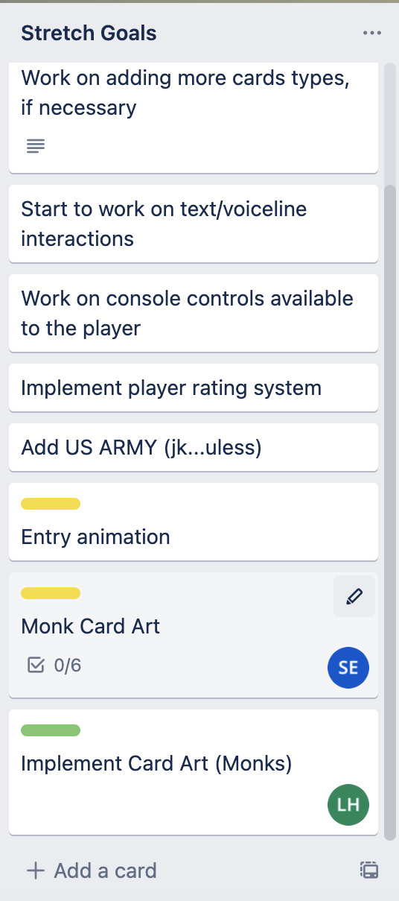
Project Management
Scope
Moved monk faction to stretch goal
Art delays led us to rescope the project to a more reasonable time frame
Moved god cards to stretch goal
Redirected programming resources to implement other core features

Slide 3
Game Design
Abilities
Vikings
Retaliation - Even if die you retaliate for half dmg
Damage is rounded to nearest integer
Knight
Heal - 20% of max. health per turn (Can’t go above max)
Healing is rounded to nearest integer
Samurai
Stun - The card attacking samurai is stunned, cannot attack or retaliate for one turn. (does not affect viking passive)
Only applies if samurai survives
Legionaries
Splash damage (adjacent enemy takes 25%) - roman
Damage is rounded to nearest integer

Slide 4
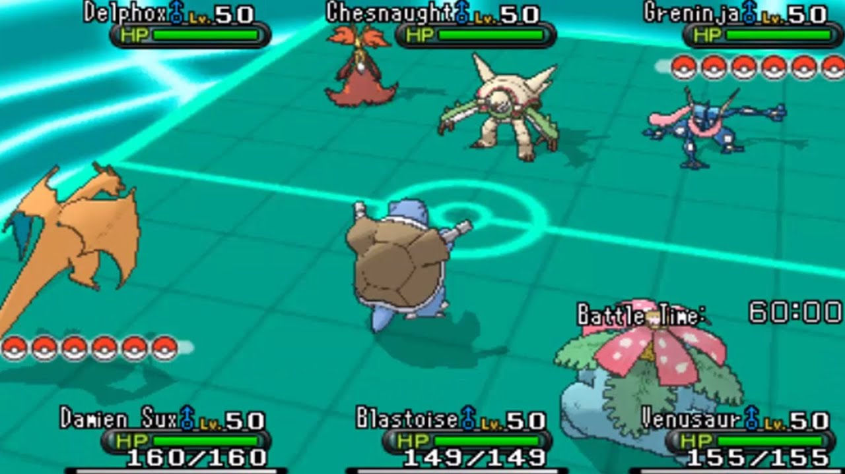
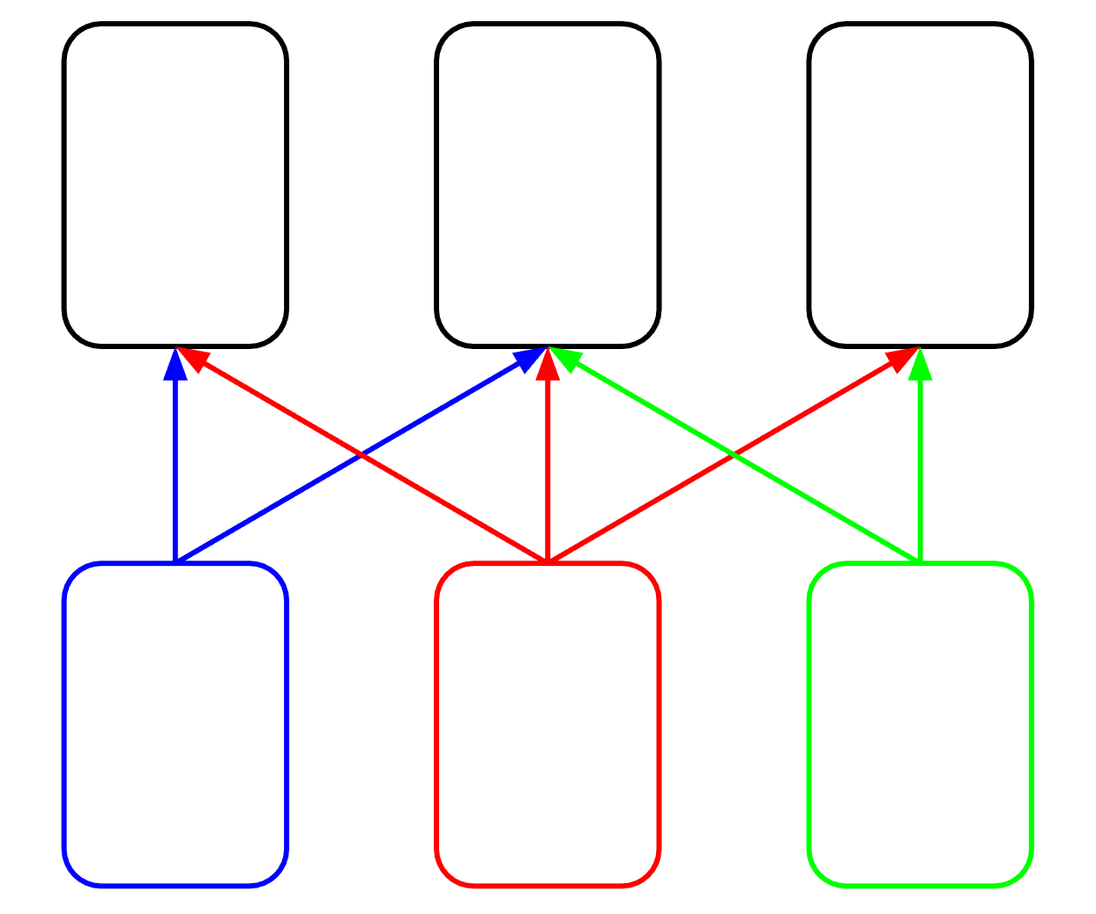
Gameplay Programming
Changes to game rules
In response to the feedback on the gameplay being repetitive.
Added positional combat, adding a layer of strategy to playing cards.
Added retaliation on a card taking damage if they survive the attack, to make combat more strategic without making some faction too strong.

Slide 5
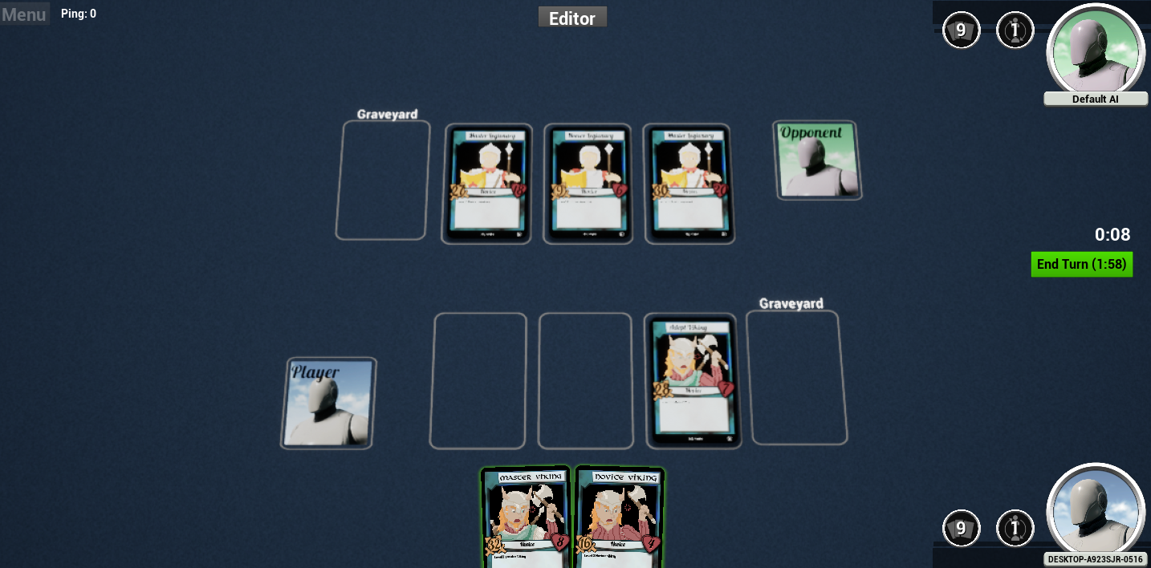
General Programming
Changes to UI
Some of the UI elements left over from the toolkit like mana and player health confused playtesters.
Playtesters also mentioned that the enemy’s cards are hard to view because they face towards the enemy and away from the player side.

Slide 6
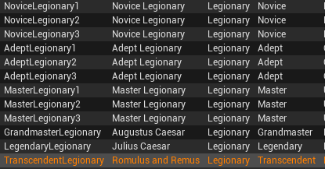
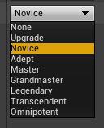
AI Programming
Major bug found where AI would not attack with certain cards
CCG Toolkit has different card types (Creature, Spell, Etc.)
Since all cards were creatures, types changed to card rank
Only “Novice” cards could be used by the AI

Slide 7
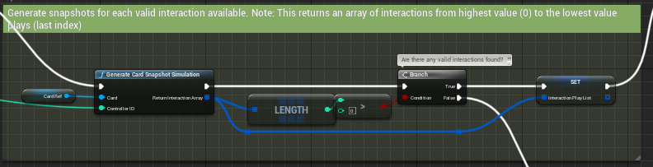
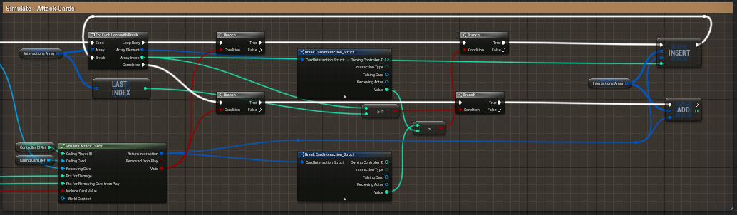
AI Programming (Con’t)
AI looks at all possible moves to find best option
Must be altered in the next milestone to better suit out game

Slide 8






Art Design
Card art completed for Roman and Knight factions
Unique palette for each faction
Monk Faction cut for time requirements
Background art added independently

Slide 9



Art Design (Con’t)
Worked on unit backgrounds
Finished card fronts
Worked on rough soundtrack inspired by other media

Slide 10
Retrospective
Timeframe estimates
Scope adjustments
Unreal blueprint system
Complicated code base (CCG Toolkit)
Problems finding good DAW (Digital Audio Workstation)
Balancing potential abilities
Terminology

Slide 11
Whats Next
Samurai Art
Auxiliary art
Passive abilities
Make AI less random and plan around the triple battle and retaliation systems
Alternative win conditions
Deck Building

Slide 12
Q&A

Slide 13
If you've seen this slide you've gone too far, turn back now
Links:
https://github.com/Long-T-Hoang/CardinalSin
https://drive.google.com/file/d/1DPOKRQQY8cbBC49xW-jDDzRwPom6JkaM/view?usp=sharing

